Slide 1

2015 State Legislative Roundup
Friday, October 10, 2015

Slide 2
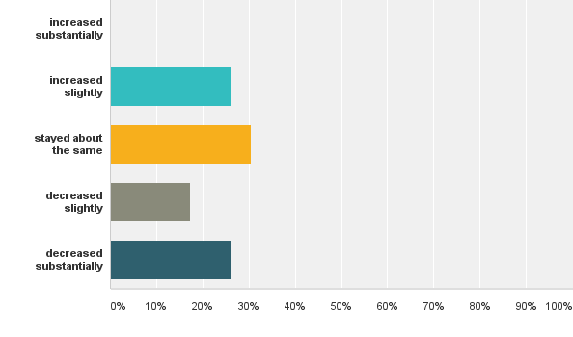
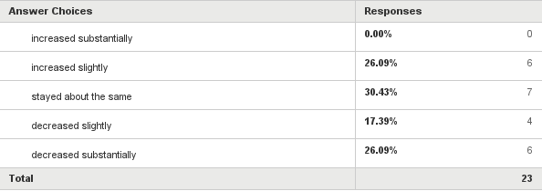

Q1: Do you believe efforts by your state legislature to establish laws and policies that provide easier access to public records has...

Slide 3
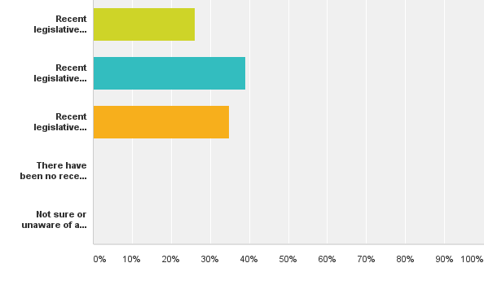
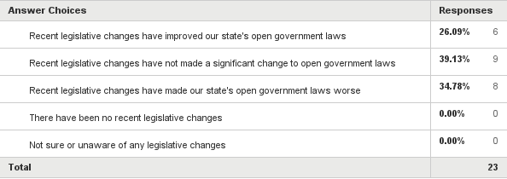
Q2: Over the past year or two, how would you rate your state's legislature's impact of reforms, amendments and legislative changes to public disclosure and open meeting laws affecting your state?

Slide 4
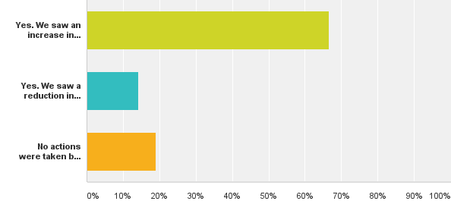
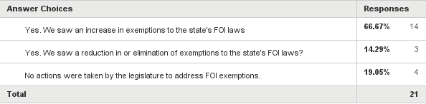
Q3: In the 2015 legislative session, were actions taken by the legislature that addressed exemptions to the state's FOI laws?

Slide 5
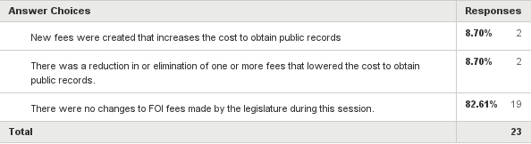
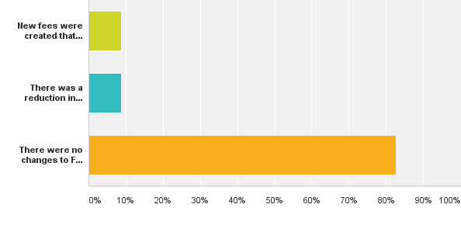
Q4: In the 2015 legislative session, what actions were taken to increase or decrease FOI/OR fees to the public?

Slide 6
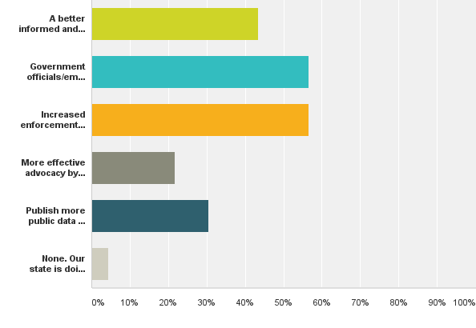
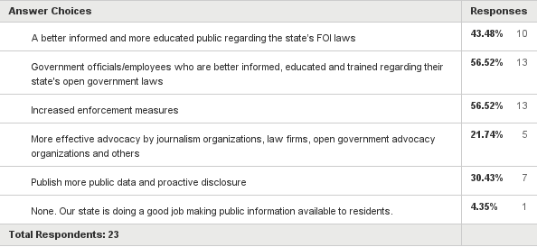
Q5: In your opinion, which of the following two responses are most needed in your state to make public information (open records) more accessible? (Please check two responses.)

Slide 7
Q6: Can you identify and describe the top FOI issue(s0 you followed during the legislative session or took action whether for or against, and what was the result?
Exemptions - Sweeping overhauls of FOI laws
Police body cameras/Law enforcement records
Fees (establishing or raising)
Publishing records - establishing repositories
Executive branch privileges – email
Email records (in general)
Voluminous/Nuisance records requests
Public Contracts
Public boards meetings - utilities, universities
Timetables for FOI suits
Top

Slide 8
2015 State Legislative Roundup
Friday, October 10, 2015

Slide 9
Friday, October 10, 2015

Slide 10
Friday, October 10, 2015

