Slide 1
Q4 2015 NFOIC/MLRC/IRE Open Government Survey
March 16, 2016

Slide 2
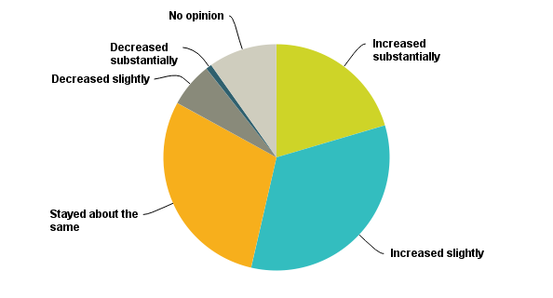
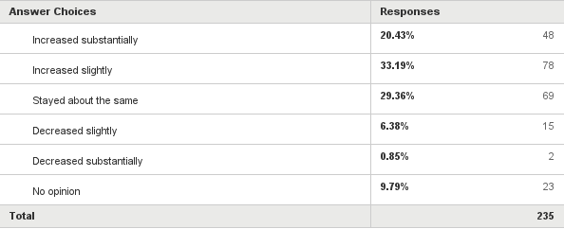
Q1: Over the past two years, do you believe the incidence of open records or proceedings violations in your state and local jurisdiction has...

Slide 3
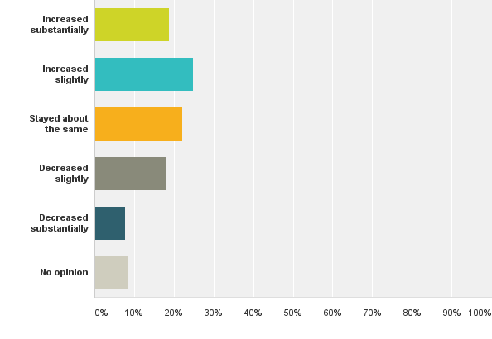
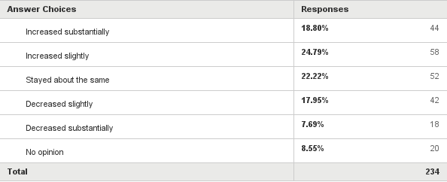
Q2: Over the past two years, do you believe that the number of professional reporters and journalists making open government requests in your state and local jurisdiction has…

Slide 4
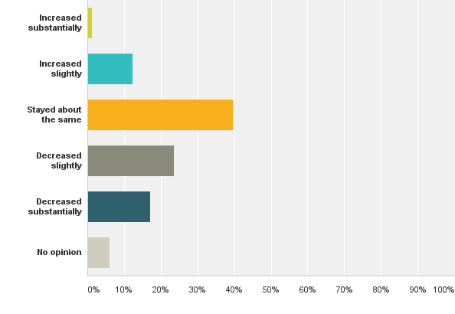
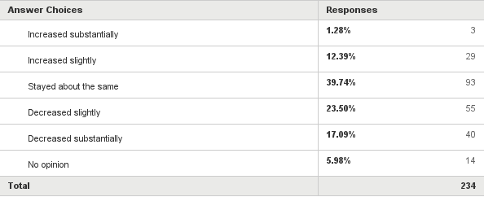
Q3: Over the past two years, do you believe that government officials' understanding of and voluntary compliance with open government requirements in your state and local jurisdiction has...

Slide 5
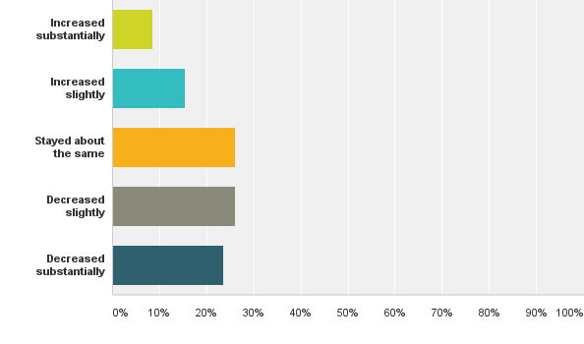
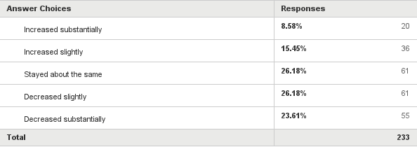
Q4: Over the past two years, do you believe that the amount of human and financial resources from media organizations devoted to litigation and legal compliance with open government requirements in your state and local jurisdiction has...

Slide 6
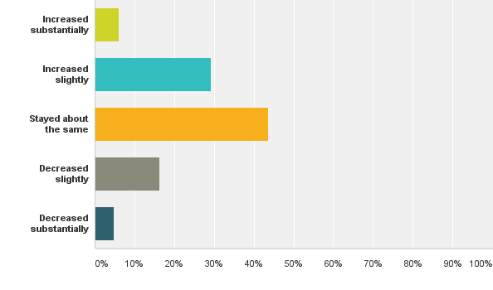
Q5: Over the past two years, do you believe that the amount of human and financial resources from good government organizations and non-profit groups devoted to litigation and legal compliance with open government requirements has...

Slide 7
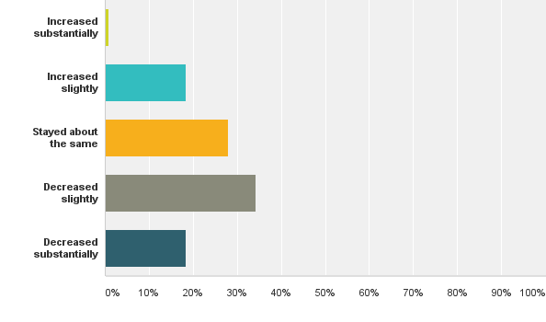
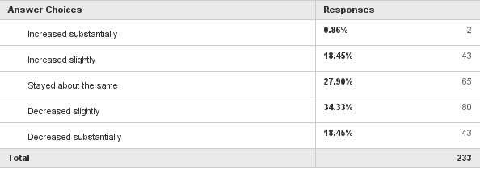
Q6: Over the past two to five years, do you believe that efforts by government to provide citizen access and comply with open government laws has...

Slide 8
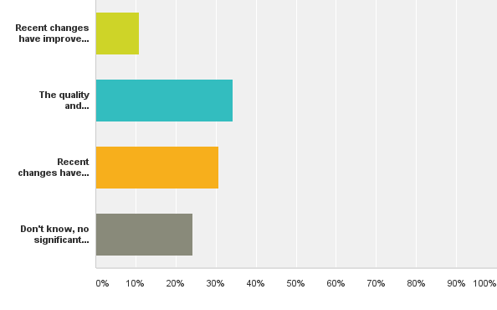
Q7: Over the past two years, how would you rate the impact of reforms, amendments and legislative changes to public disclosure and open meeting laws affecting your state?

Slide 9
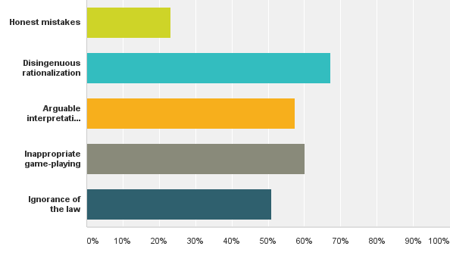
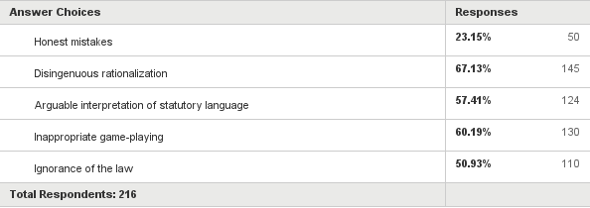
Q8: In cases in which government officials have denied access for reasons with which you disagree, do you believe the denial was based on...(Check all that apply)

Slide 10
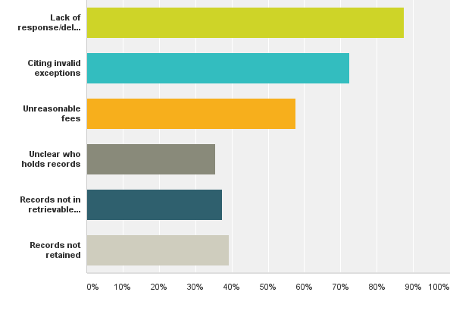
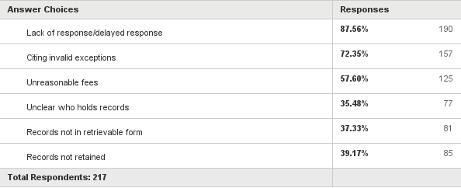
Q9: What obstacles have you faced from government officials who deny access to information? (Check all that apply)

Slide 11
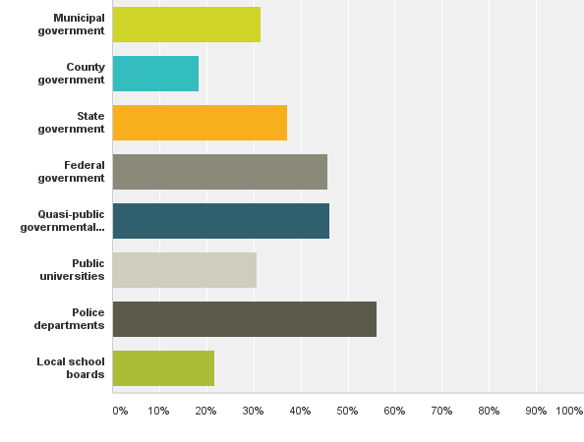
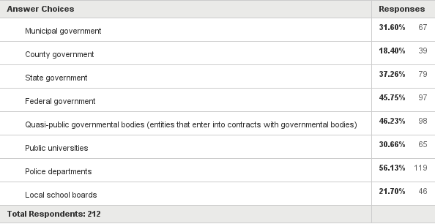
Q10: What types of agencies are most difficult for private citizens, journalists, and other petitioners to obtain information? (Check up to three answers)

Slide 12
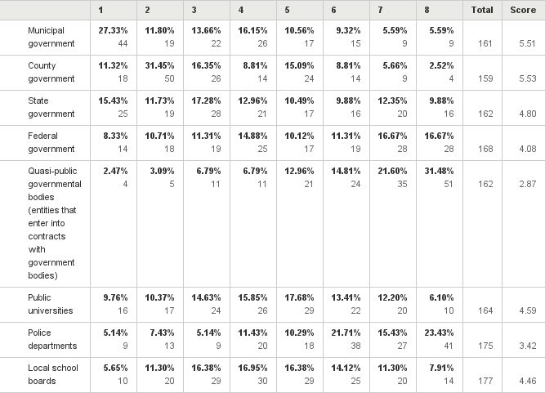
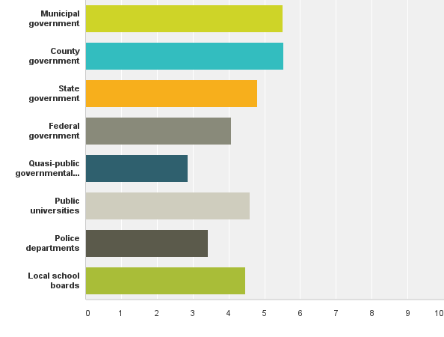
Q11: Please rank the following agencies as being the most transparent and/or cooperative? (One being the most transparent, and eight as the least transparent and/or cooperative)

Slide 13
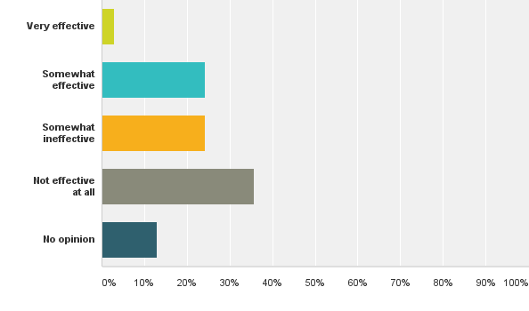
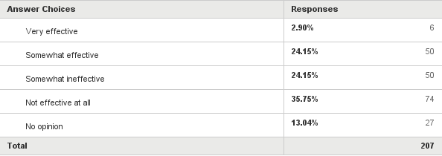
Q12: In your area, how would you rate the effectiveness of enforcement measures in non-compliance cases?

Slide 14
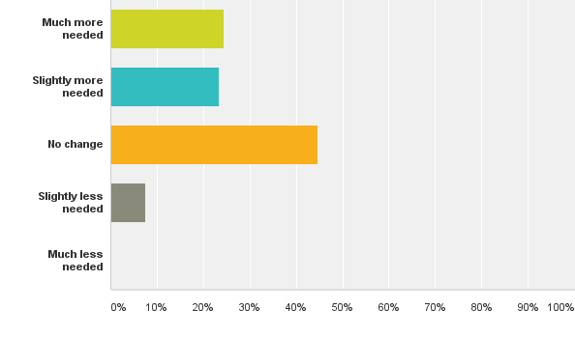
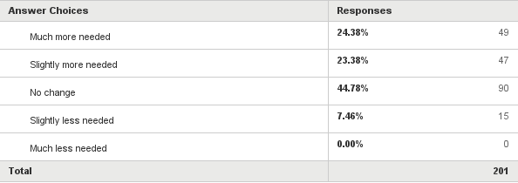
Q13: Have emerging forms of public data and proactive disclosures made your advocacy services and resources more or less needed/valuable than they were two years ago?

Slide 15
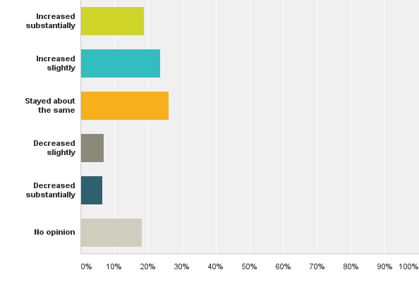
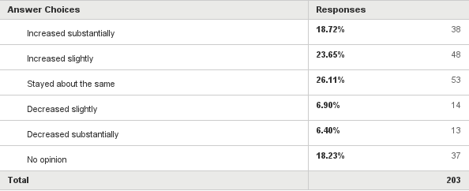
Q14: Over the past two years, do you believe the number of instances in which your organization has intervened in an open government matter for clients or the public has...

Slide 16
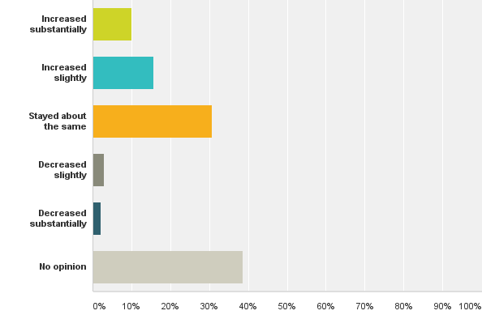
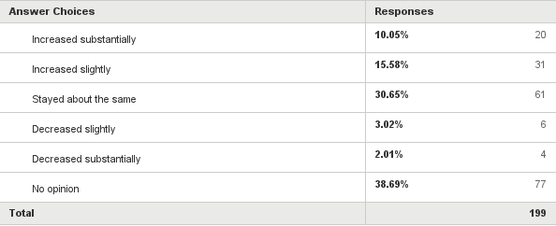
Q15: Over the past two years, do you believe the number of instances in which your organization has intervened in an open government matter for non-media clients or the public has...

Slide 17
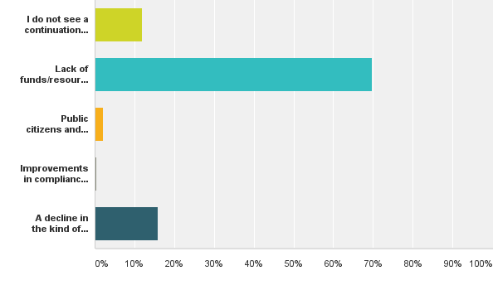
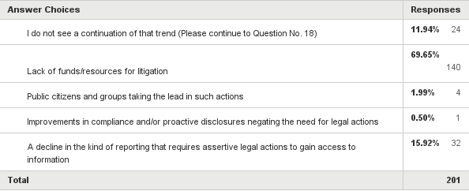
Q16: Our past surveys on these topics have shown declining media interest and involvement in litigation and legal actions regarding open government matters. Do you see that trend continuing, and if so to what do you primarily attribute it?

Slide 18
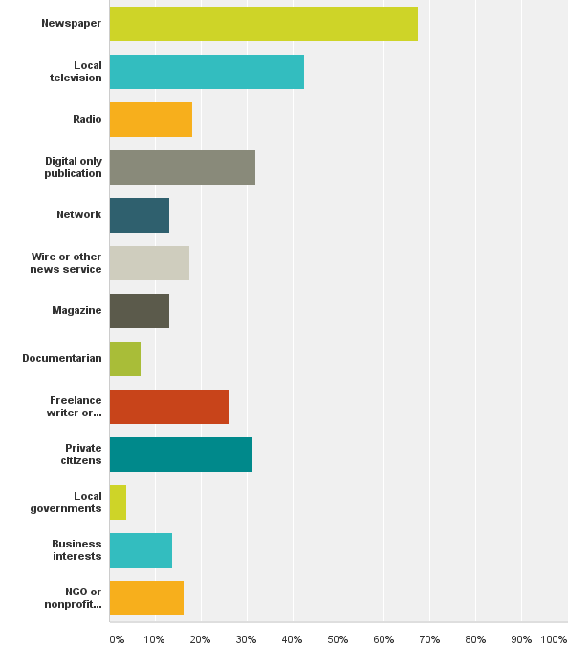
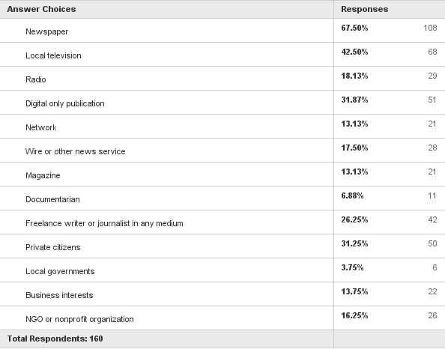
Q17: What kind(s) of clients has your organization represented in open government matters? (Check all that apply)

Slide 19
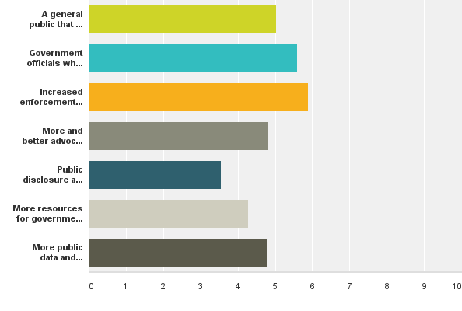
Q18: In your opinion, which of the following is most needed to make public information from agencies more accessible? (Please rank your top three choices)

Slide 20
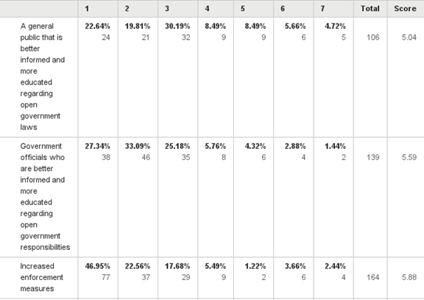
Q18: In your opinion, which of the following is most needed to make public information from agencies more accessible? (Please rank your top three choices)
1.
2.
3.

Slide 21
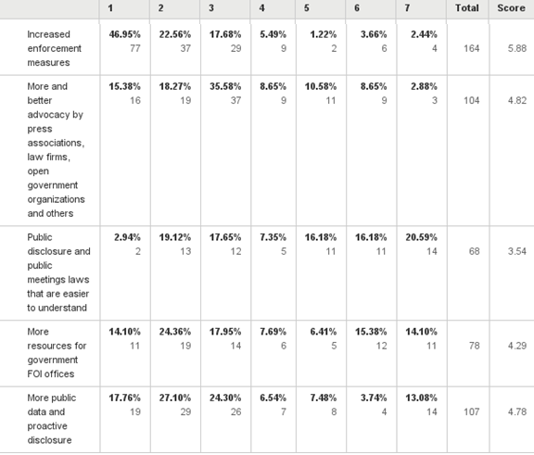
Q18: In your opinion, which of the following is most needed to make public information from agencies more accessible? (Please rank your top three choices) cont.
4.
5.
6.
7.
8.

Slide 22
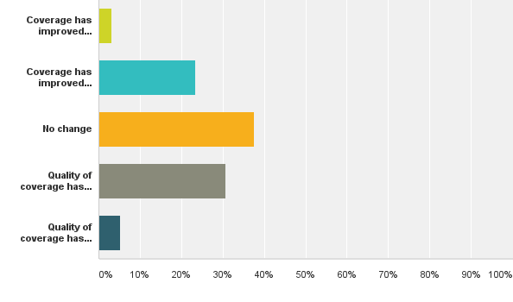
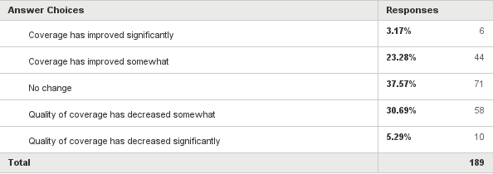
Q19: In your opinion, how has the changing landscape of government access over the past two years affected the quality of news coverage in your area?

Slide 23
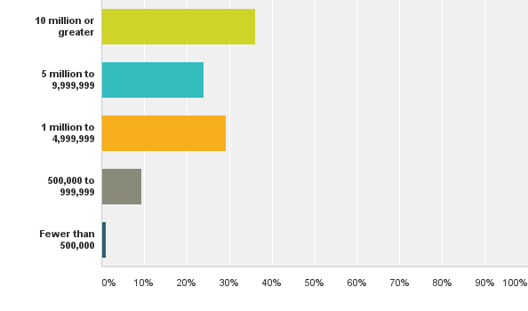
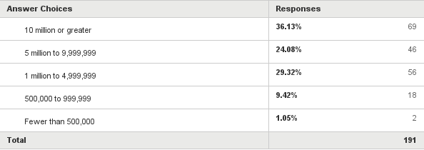
Q20: What is the current population of the state or territory in which you reside or work?

Slide 24
END
Q4 2015 NFOIC/MLRC/IRE Open Government Survey
March 16, 2016

